Slide 1

http://flic.kr/p/ar4nLn
Databases and the MVC Model

Slide 2
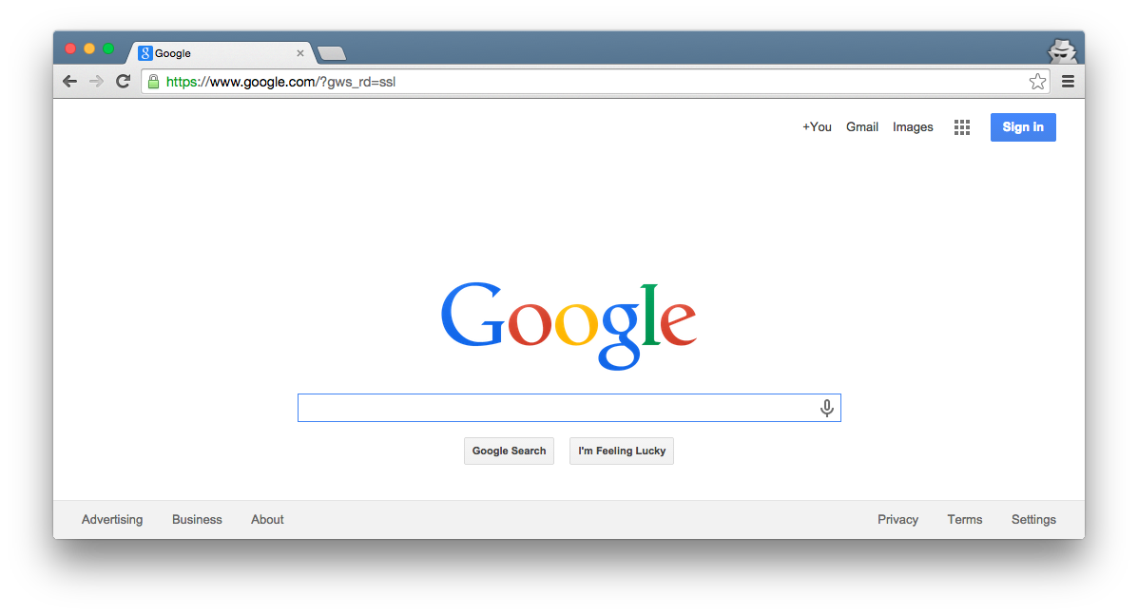

Browser
Migrations
Ye Olde
Internet
DB
Server
View
Router
Controller
Model

Slide 3
Browser
Today’s focus
Migrations
Ye Olde
Internet
DB
Server
View
Router
Controller
Model

Slide 4
Database (DB): Organized collection of data
Database Management System (DBMS): Controls the creation, maintenance, and use of a DB
http://flic.kr/p/ar4nLn

Slide 5
Browser
Migrations
Rails uses
a DBMS
Ye Olde
Internet
DB
Server
View
Router
Controller
Model

Slide 6
Why use a DBMS?
Data independence: Applications need not be concerned with how data is stored or accessed
Provides a lot of functionality that would be silly to implement yourself:
  Sharing (network)
  Customizable security
  Integrity

Slide 7
Browser
Migrations
Ye Olde
Internet
You make migrations to set up the database
DB
Server
View
Router
Controller
Model

Slide 8
Browser
Migrations
Ye Olde
Internet
You make model classes to use the database
DB
Server
View
Router
Controller
Model

Slide 9
Two key aspects of a DBMS
Database model: How DB is structured and used
  Examples: Relational, Object-Oriented, Hierarchical
Query language: Types of questions you can ask
  Examples: SQL, XQuery
Relational model + SQL is most common
and used by Rails

Slide 10
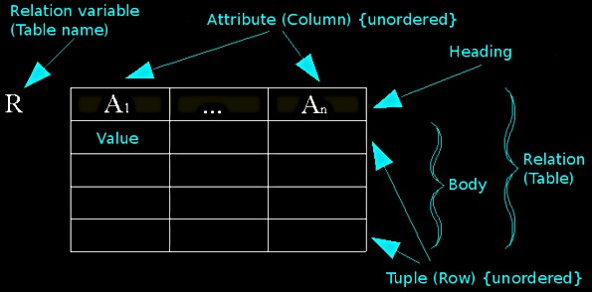
Relational Model Concepts
http://en.wikipedia.org/wiki/File:Relational_model_concepts.png

Slide 11
Example Tables
authors
id | first_name | last_name | year_born
1 | Ayn | Rand | 1905
2 | Peter | Benchley | 1940
publishers
id | publisher_name
1 | Bobbs Merrill
2 | Random House

Slide 12
How DBs are used by apps
Pre-deployment of app:
  Create (empty) tables
  Maybe “seed” with data
At runtime of app:
  CRUD table rows
  NOTE: Tables/columns don’t change
authors
id | first_name | last_name | year_born
1 | Ayn | Rand | 1905
2 | Peter | Benchley | 1940

Slide 13
CRUD-to-SQL Mapping
CRUD Operation | SQL Statement
Create | INSERT
Read (Retrieve) | SELECT
Update (Modify) | UPDATE
Delete (Destroy) | DELETE
For complete MySQL documentation, see: http://dev.mysql.com/doc/refman/5.5/en/sql-syntax-data-manipulation.html

Slide 14
Example SELECT Queries
authors
id | first_name | last_name | year_born
1 | Ayn | Rand | 1905
2 | Peter | Benchley | 1940
SELECT * FROM authors
SELECT id, last_name FROM authors
SELECT * FROM authors WHERE year_born > 1910
SELECT * FROM authors WHERE last_name LIKE 'r%'
SELECT * FROM authors WHERE last_name REGEXP '[a-r]*'
SELECT * FROM authors WHERE last_name REGEXP '[a-r]*'
ORDER BY last_name ASC
For complete MySQL documentation, see http://dev.mysql.com/doc/refman/5.5/en/select.html ,http://dev.mysql.com/doc/refman/5.5/en/pattern-matching.html

Slide 15
Rails Object-Relational Mapping (ORM)
You make object-oriented classes
Rails handles the SQL/DBMS
DB
Model

Slide 16
Quick Intro to UML Class Diagrams
I use class diagrams a lot
Rationale: Easier to see “big picture” relationships than in code
Example model class:
Class name
Author
Box = class
first_name : string
last_name : string
year_born : integer
Attributes w/ types

Slide 17
Classes Represent Sets of Possible Objects
Class Diagram:
Object Diagram
Object name
Class
Author
rand : Author
first_name : string
last_name : string
year_born : integer
first_name = “Ayn”
last_name = “Rand”
year_born = 1905
Attribute values
: Author
first_name = “Peter”
last_name = “Benchley”
year_born = 1940

Slide 18
Example Mapping from Class to Table
Author
first_name : string
last_name : string
year_born : integer
You get ID for free
authors
id | first_name | last_name | year_born
1 | Ayn | Rand | 1905
2 | Peter | Benchley | 1940

Slide 19
What do objects map to?
: Author
: Author
first_name = “Ayn”
last_name = “Rand”
year_born = 1905
first_name = “Peter”
last_name = “Benchley”
year_born = 1940
authors
id | first_name | last_name | year_born
1 | Ayn | Rand | 1905
2 | Peter | Benchley | 1940

Slide 20
What do objects map to?
Rows!
: Author
: Author
first_name = “Ayn”
last_name = “Rand”
year_born = 1905
first_name = “Peter”
last_name = “Benchley”
year_born = 1940
authors
id | first_name | last_name | year_born
1 | Ayn | Rand | 1905
2 | Peter | Benchley | 1940

Slide 21
How to make a model class
Run Rails command:
$ rails g model Author first_name:string last_name:string year_born:integer
What it generates:
  Model class: used by controller classes
    app/models/author.rb
    class Author
  DB migration class: used to setup tables in DB
    db/migrate/20141030033652_create_authors.rb
  Test class: used to test your model class
    test/models/author_test.rb
Demo time!

Slide 22
Appendix

Slide 23
Browser
Migrations
Ye Olde
Internet
Tests
DB
Server
View
Router
Controller
Model

